Slide 1
FlexTRAK-2MB
Plasma System

Slide 2
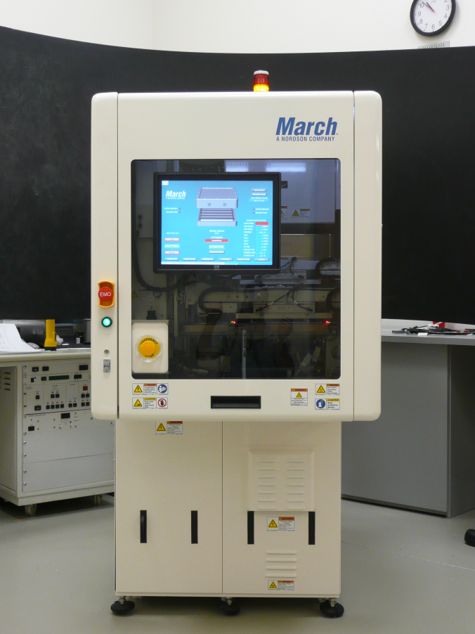
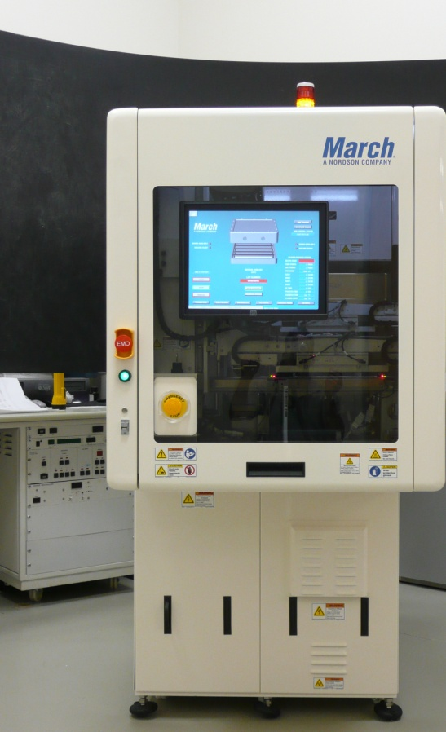
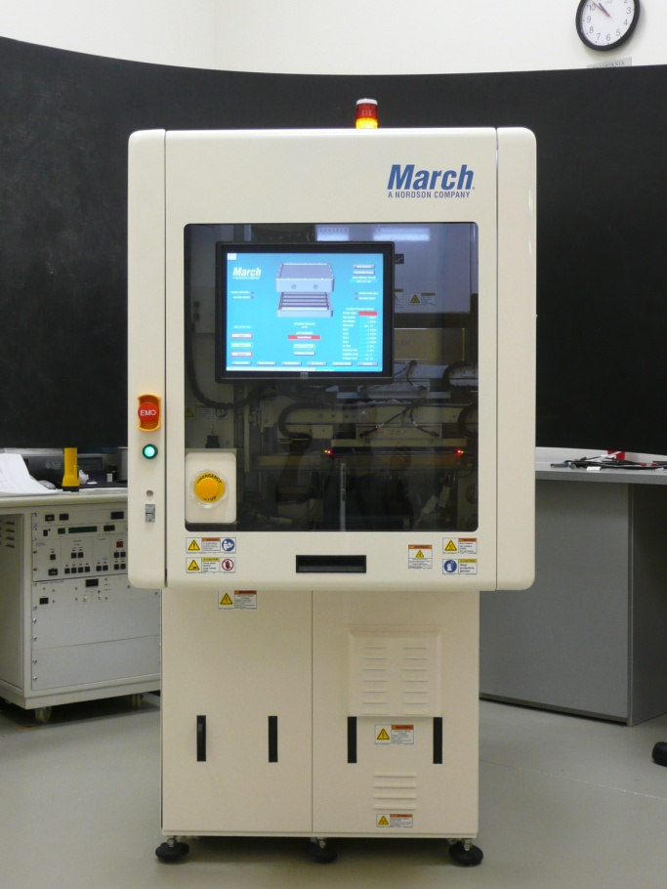
FlexTRAK-2MB

Slide 3
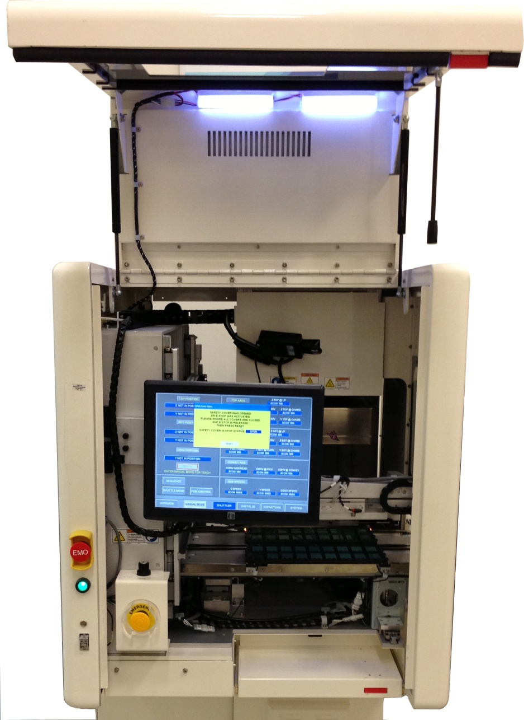
FlexTRAK-2MB: Handling and Transfer
Handling and Chamber Access Door
Touch Screen Control HMI
Process Chamber
2-Lane Conveyor System
Robot Pincher Arms

Slide 4
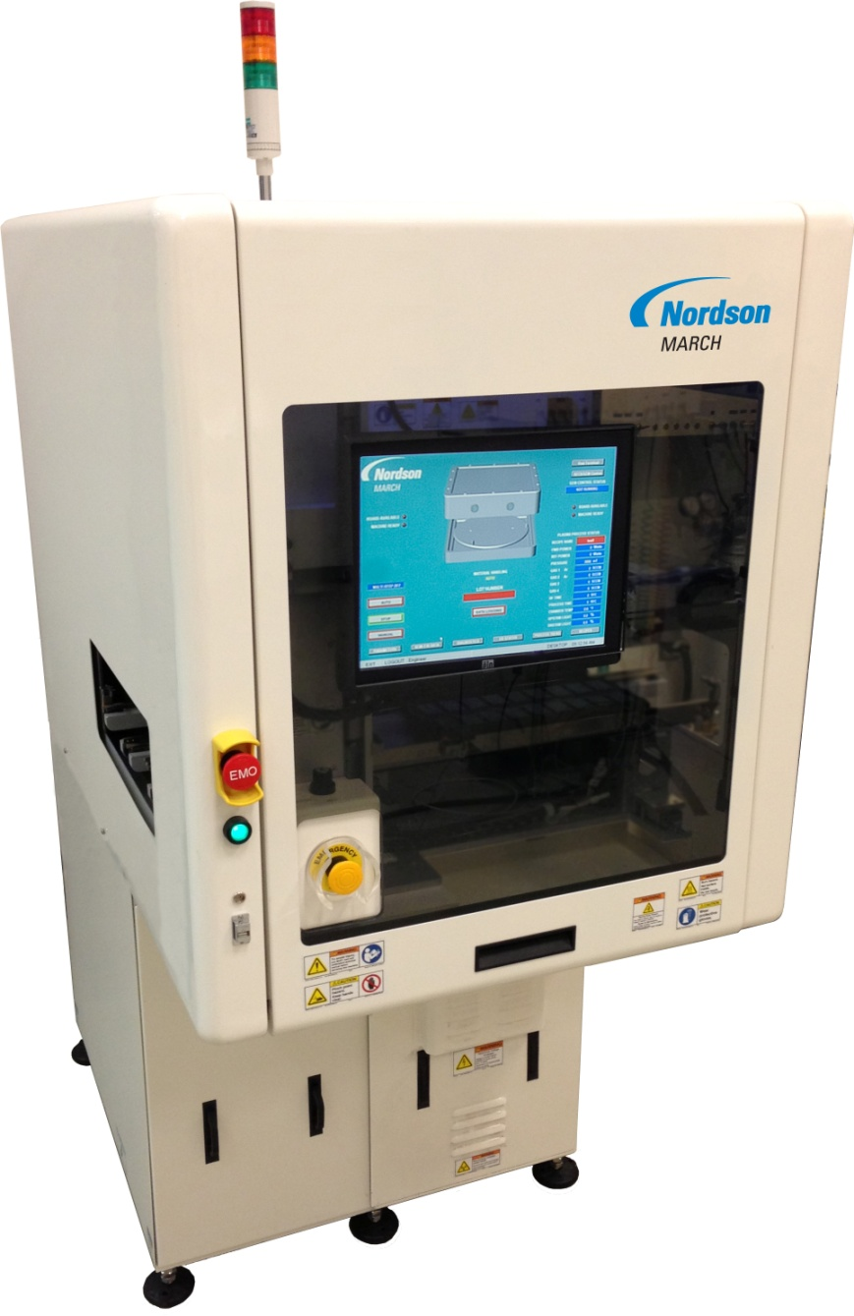
FlexTRAK-2MB: Overview
Inline input and output areas
Handling and Chamber access door
Touch Screen Control HMI
Pump, Power and Service Area

Slide 5
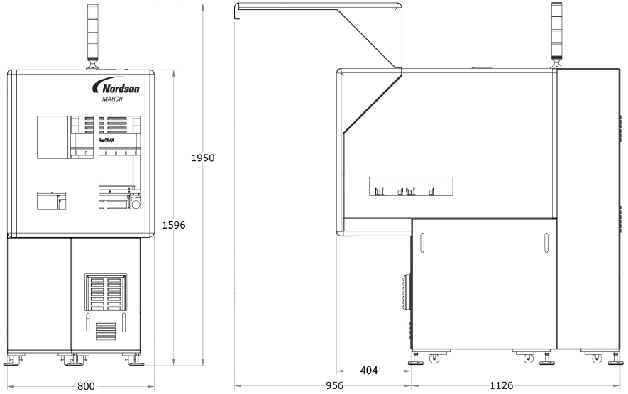
FlexTRAK-2MB: Tool Layout

Slide 6
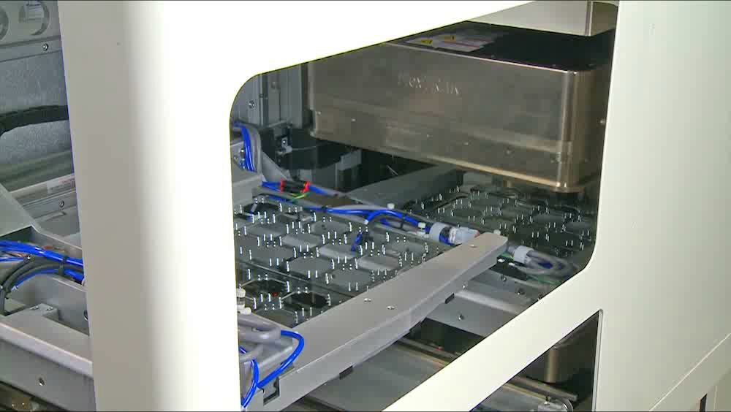
How it Works

Slide 7
FlexTRAK-2MB Key Characteristics
Handling and processing of substrates using “edge grip”
Inline processing of microelectronic devices held in boats, trays and similar carriers
Single or Dual-lane conveyor transport system minimalises loading/unloading time
Optional shuffler allows transition from single-lane to double-lane and back
“Pass Through” feature enables chaining of systems
Self-contained, modular design (all components internal to the system enclosure)
Intuitive operation and control via touch-screen graphical user interface (GUI)

Slide 8
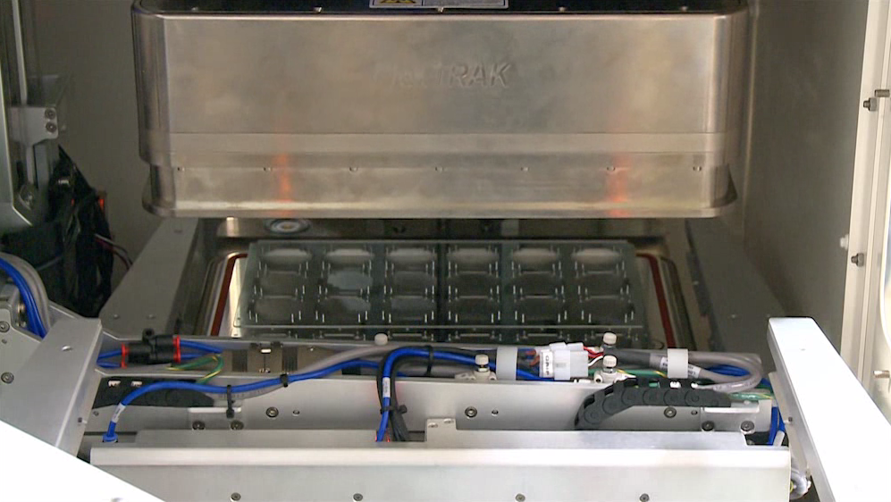
FlexTRAK-2MB: Key Numbers
Footprint – L x W x H (mm)
  800 x 1530 x 1596 (1950 w/ light tower)
Electrode Dimensions – L x W (mm)
  305 x 305
RF Power (W)
  600 @ 13.56MHz
MFCs
  2 standard (4 maximum)
Pump
  16 CFM dry pump

Slide 9
FlexTRAK-2MB: Typical Cycle Times
Loading/Unloading
  5 seconds
Pump-down
  12 seconds
Bleed
  2 seconds
Process
  15 to 60 seconds
Capacity
  2 per cycle for 50 to 150mm wide boats
  1 per cycle for 151 to 305mm wide boats
Throughput “Best Case”
  180 UPH for 50 to 150mm wide boats
  90 UPH for 151 to 305mm wide boats

Slide 10
FlexTRAK-2MB:Integration
Standard SMEMA interface for upstream and downstream communication
Fully compliant with SECS/GEMS
SEMI-E10 Data Collected

Slide 11
FlexTRAK-2MB:RF System
RF Generator
  13.56 MHz Solid-state RF Generator (Seren)
  600 Watt
  Automatic tuning network with March’s patented SmartTune™ technology
    Provides fast & stable matching capability

Slide 12
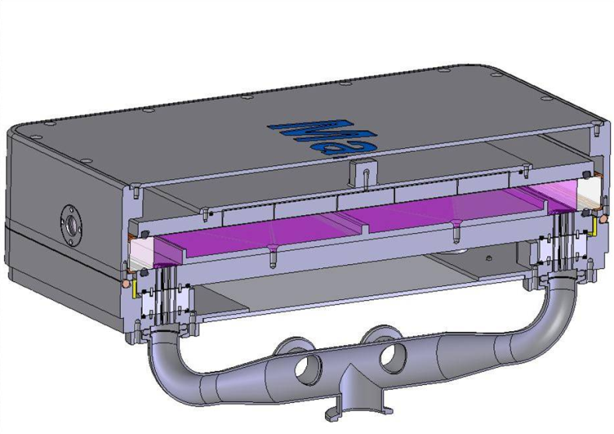
FlexTRAK-2MB: F3 Chamber
F3 Chamber Overview
Increases:
  Density of plasma
  Uniformity of plasma
Reduced plasma chamber volume
  Improves pump-down & bleed time ➔ higher throughput
Chamber volume can be changed
  Based on customer application, product size, etc.

Slide 13
FlexTRAK-2MB: Plasma Modes
Plasma Modes
  Direct Plasma is standard
    Plasma modes available: Power-Ground, Ground-Power or Power-Power
    Mode depends on application(s)
  Ion Free Plasma (IFP) is optional
    Reduced ion, electron, and light exposure on product
    Pure free radical (chemical) plasma treatment – no sputtering
    Retrofit possible (as future requirements change)

Slide 14
FlexTRAK-2MB: Process Gases
System can handle all common process gases
  Typical process gases are O₂, Ar, CF₄, SF₆, N₂, H₂, H₂/N₂ (forming gas), He
Helium and Hydrogen are limited to <50% concentration by volume due to vacuum pump characteristics

Slide 15
FlexTRAK-2MB: Gas Control
System uses Mass Flow Controller (MFC) for each process gas
2 MFCs standard
Additional MFCs (up to 4 total) available as an option
Mixtures achieved by running MFC’s simultaneously

Slide 16
FlexTRAK-2MB: Vacuum System
Pump: Adixen ACP-28 dry pump (Pfeiffer)
Process pressure operating range (typical)
  80 to ca. 1,600 mTorr
  Pressure control accomplished via:
    Variable Speed Vacuum Pump
    Gas Flow
  Monitored using Pirani gauge

Slide 17
FlexTRAK-2MB: Process Programming
Process Recipe Changes
  Recipe changes can be accomplished < 2 minutes
  Unlimited number of recipes
Access and Use
  Touchscreen PC interface
  Manual or automatic system control
  Multi-level security access (3 levels standard)

